Slide 1

ANALYSIS OF ALGORITHMS
TOPIC 1.1.2
By: Er.Bhavneet Kaur
Master Subject Co-ordinator
CSE 2nd Year

Slide 2
COMPLEXITY ANALYSIS OF ALGORITHMS
Input
Algorithm
Output
An algorithm is a step-by-step procedure for
solving a problem in a finite amount of time.

Slide 3
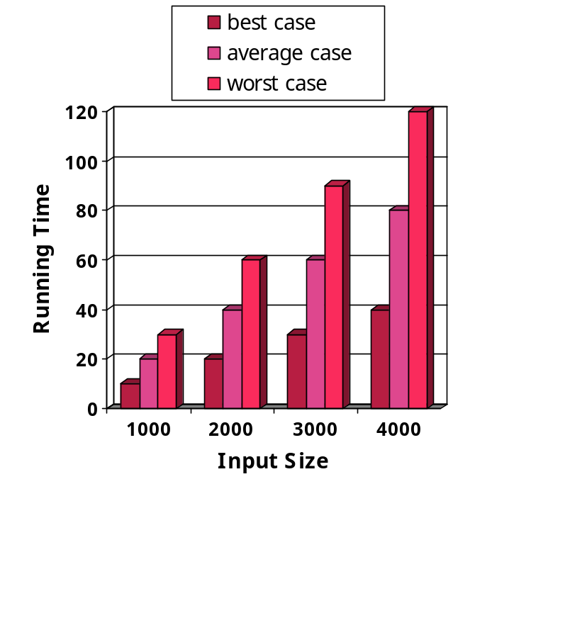
RUNNING TIME
Most algorithms transform input objects into output objects.
The running time of an algorithm typically grows with the input size.
Average case time is often difficult to determine.
We focus on the worst case running time.
  Easier to analyze
  Crucial to applications such as games, finance and robotics

Slide 4
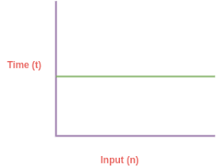
TIME COMPLEXITY
The number of times it takes to execute a specific algorithm given the length of the input is known as its temporal complexity.
Not a measure of how long an algorithm takes to run: Since operating system, processor power, and programming language are taken into account
The amount of time it takes for each statement to be completed is the algorithm's temporal complexity.
Depends on the volume of the processed data. It also helps in determining the efficacy and performance evaluation of an algorithm.

Slide 5
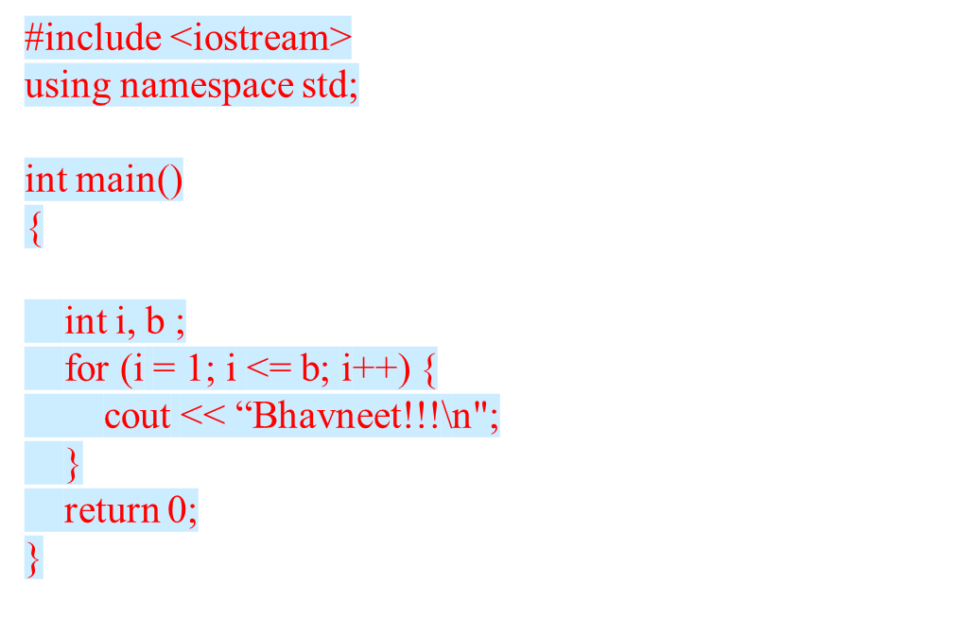
Example,
Here in the goiven code snippet ,”Bhavneet” is printed n times since the value will be assigned at run time.
So,the time complexity is linear: O(n) i.e. every time, a linear amount of time is required to execute code.

Slide 6

SPACE COMPLEXITY
When an algorithm is run on a computer, it necessitates a certain amount of memory space.
The amount of memory used by a program to execute .
Space complexity is auxiliary and input space: Program requires memory to store input data and temporal values while running

Slide 7
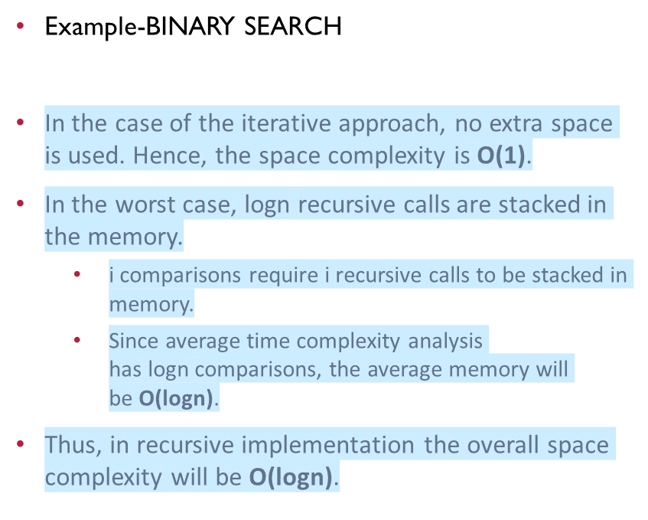
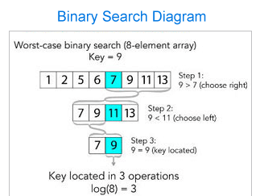
Analysis of Algorithms

Slide 8
IMPORTANCE OF TIME COMPLEXITY & SPACE COMPLEXITY
The input size has a strong relationship with time complexity. As the size of the input increases, so does the runtime, or the amount of time it takes the algorithm to run.
Example
Let there be set of numbers,
S= (10, 50, 20, 15, 30)
The provided numbers can be sorted using a variety of algorithms.
You need to do computational analysis on each algorithm to find the most efficient one.
This includes space and time complexity for each.

Slide 9
HOW TO MEASURE TIME COMPLEXITY OF AN ALGORITHM?
Identify the Input Size: Determine the variable that represents the size of the input. This is often denoted as nnn.
Count Basic Operations: Identify the basic operations in the algorithm, such as comparisons, assignments, and arithmetic operations. Count how many times these operations are executed relative to the input size.
Find the Most Significant Term: Express the count of operations as a function of the input size. Focus on the term that grows the fastest as the input size increases. This term dictates the overall time complexity.
Express in Big-O Notation: Use Big-O notation to express the time complexity. Big-O notation captures the asymptotic behaviour of the algorithm, ignoring constant factors and lower-order terms.

Slide 10
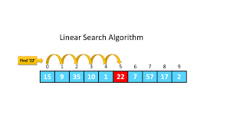
EXAMPLE
Consider a simple example of a linear search algorithm:
def linear_search(arr, target):
for i in range(len(arr)):
if arr[i] == target:
return i
return -1
Steps to Determine Time Complexity:
Identify the Input Size: The input size nnn is the length of the array arrarrarr.
Count Basic Operations: The basic operation here is the comparison arr[i] == target, which occurs inside the loop. The loop runs nnn times in the worst case.
Find the Most Significant Term: The number of comparisons is directly proportional to the input size nnn.
Express in Big-O Notation: The time complexity is O(n)O(n)O(n).

Slide 11
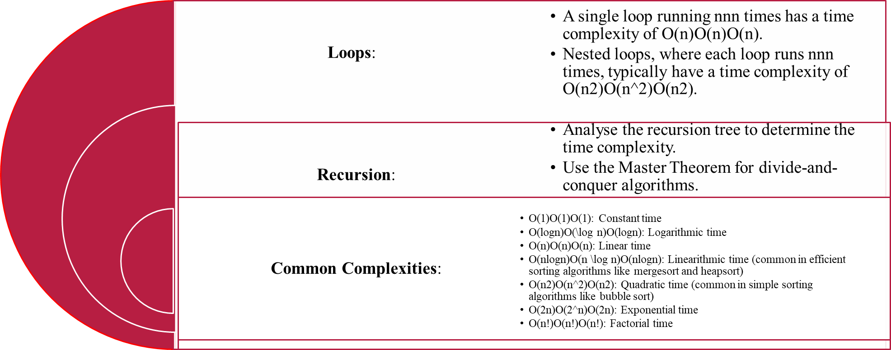
Different cases for analysing time complexity:

Slide 12
HOW TO MEASURE TIME COMPLEXITY OF AN ALGORITHM?
Identify the Input Size: Determine the variable that represents the size of the input, often denoted as nnn.
Count the Memory Usage: Identify the memory consumed by variables, data structures, and function call stacks.
Find the Most Significant Term: Express the memory usage as a function of the input size. Focus on the term that grows the fastest as the input size increases.
Express in Big-O Notation: Use Big-O notation to express the space complexity, ignoring constant factors and lower-order terms.

Slide 13
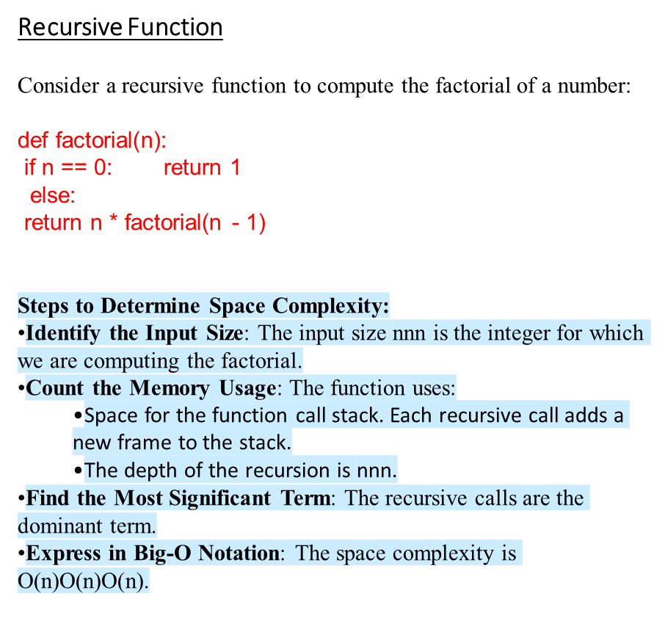
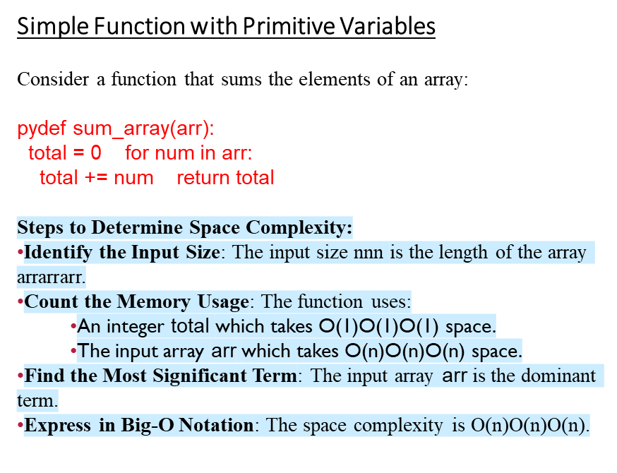
EXAMPLES

Slide 14
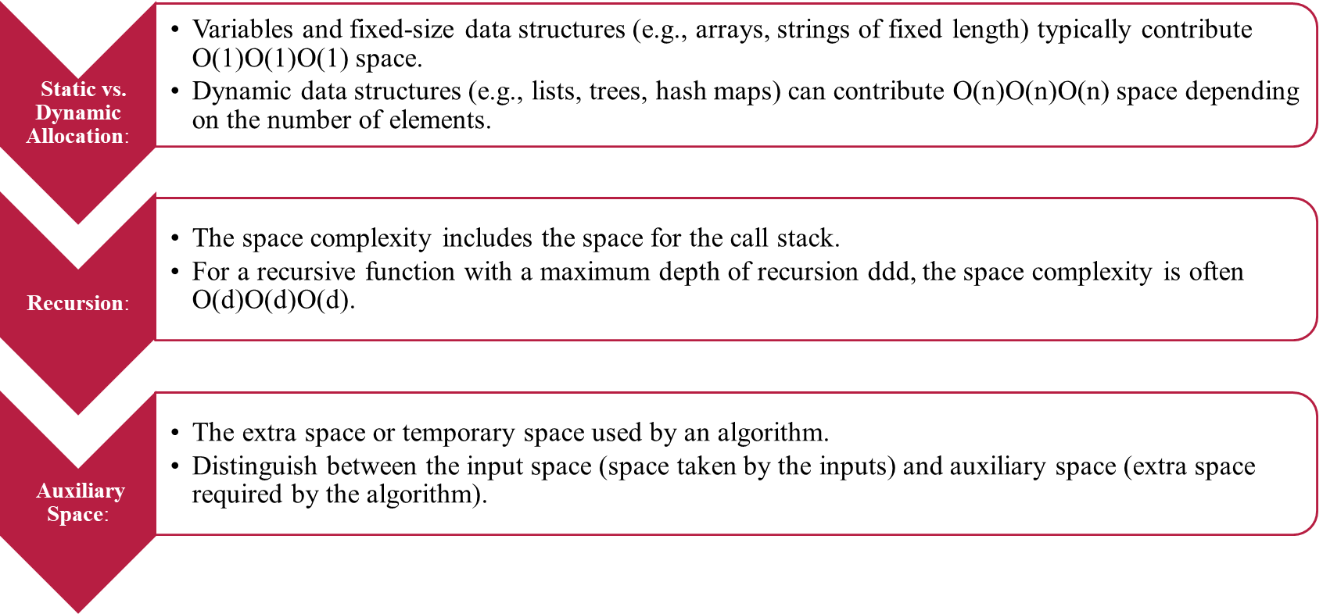
DIFFERENT CASES FOR ANALYZING SPACE COMPLEXITY

Slide 15
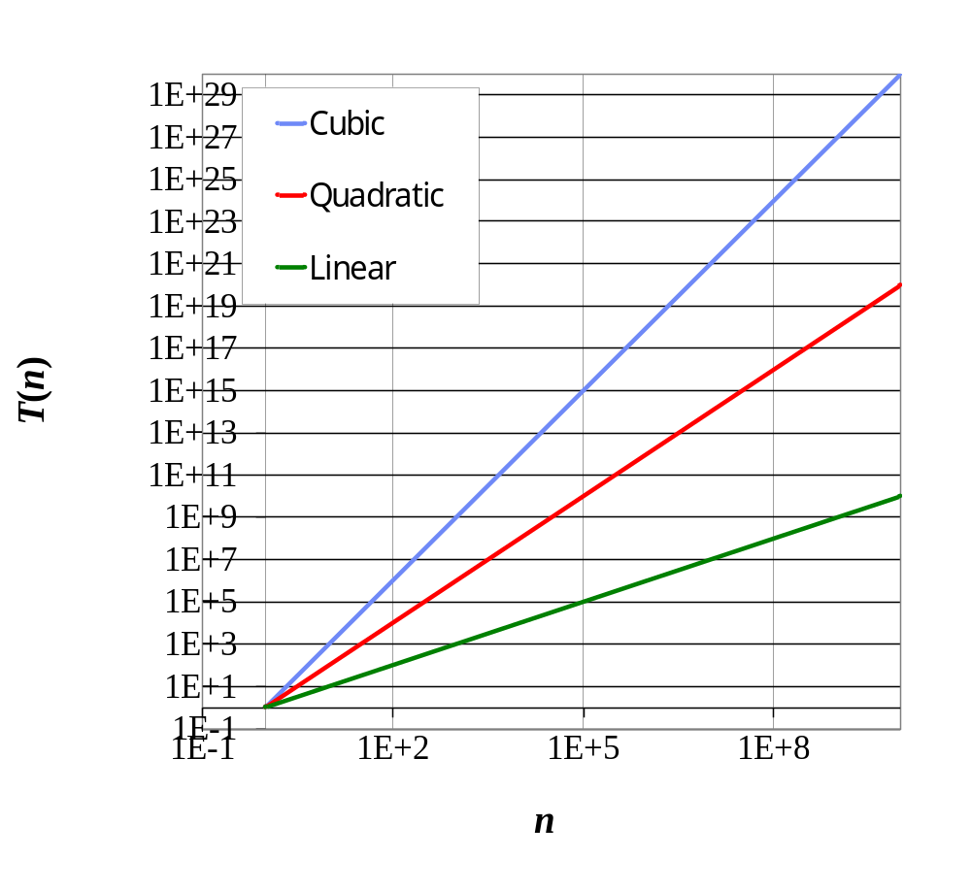
SEVEN IMPORTANT FUNCTIONS
Seven functions that often appear in algorithm analysis:
  Constant ≈ 1
  Logarithmic ≈ log n
  Linear ≈ n
  N-Log-N ≈ n log n
  Quadratic ≈ n²
  Cubic ≈ n³
  Exponential ≈ 2^{n}
In a log-log chart, the slope of the line corresponds to the growth rate of the function

